Slide 1
Smart Connected Community
Rohit Bhanot
Head – Nokia Public Sector Practice (NA)
Nokia

Slide 2
the global smart cities phenomenon - drivers & vision
-narrated by Nokia
Notes:
Nokia is a global leader in creating the technologies at the heart of our connected world.
We believe we have the industry’s most comprehensive end-to-end portfolio and services.
We are building extraordinary networks, devices, software and ecosystems… Making communities smarter…transportation safer… enterprises more agile.
We put people in charge of their wellness… experiences… choices… lives… and the way they spend their time.
Robots collaborating with humans
public safety drones saving lives
smart homes that help seniors remain independent and safe
smarter, more sustainable cities and utilities
self-driving cars
remote surgery.
These are just a few of many ways that Nokia touches people lives and connect society.

Slide 3
...a city can be defined as “smart” when investments in human and social capital and traditional (transport) and modern (ICT) communication infrastructure fuel sustainable economic development and a high quality of life, with a wise management of natutal resources..
-Smart Cities Wikipedia

Slide 4


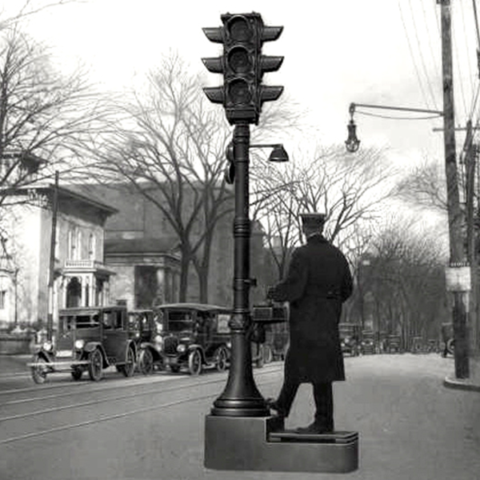
The Quest for a Smart Cities centuries old!
Urban infrastructure & services
e.g. Roman Sewer
Urban environment
e.g. Passive Cooling
Urban infrastructure & services
e.g. Intelligent Transport
4
© 2017 Nokia

Slide 5
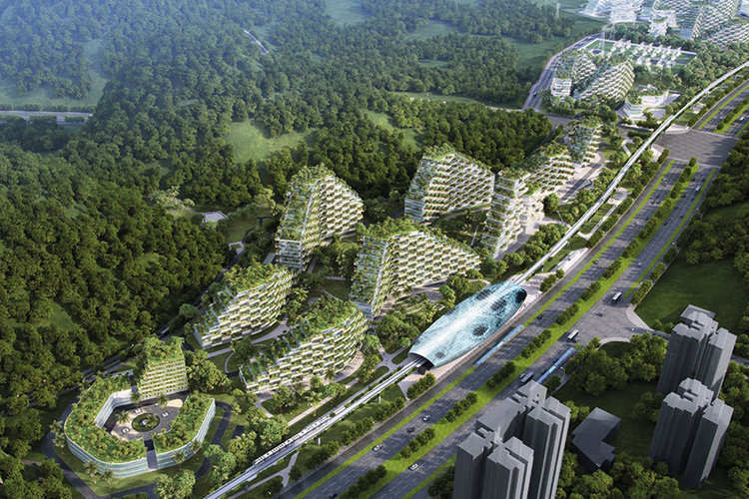
City of 40,000 Trees
A rendering of the upcoming "forest city" in Liuzhou, China

Slide 6
...there is no universally accepted definition of a smart city. It means different things to different people. The conceptualization of a Smart City therefore varies from city to city, community to community and country to country. A smart city would have a different connotation in the California, than say Oklahoma or in India, than, say Singapore..

Slide 7
Smart Community –
Drivers & Vision
-drivers & vision
Notes:
Nokia is a global leader in creating the technologies at the heart of our connected world.
We believe we have the industry’s most comprehensive end-to-end portfolio and services.
We are building extraordinary networks, devices, software and ecosystems… Making communities smarter…transportation safer… enterprises more agile.
We put people in charge of their wellness… experiences… choices… lives… and the way they spend their time.
Robots collaborating with humans
public safety drones saving lives
smart homes that help seniors remain independent and safe
smarter, more sustainable cities and utilities
self-driving cars
remote surgery.
These are just a few of many ways that Nokia touches people lives and connect society.

Slide 8



In an ultra-urbanized future, how will cities provide the best quality of life?
By being:
SMART
SAFE
SUSTAINABLE
Notes:
The profound implications of global changes resulting from increased urban concentration require a new way of operating, with new ideas, new knowledge and new technologies. Of course, new infrastructure and applications only make a difference when they actually enrich people’s lives. Responsive, flexible technology that works for humanity is what makes cities “smart” — and creates a safer, sustainable environment.

Slide 9



What a smart city must achieve??
Safe
Smart
Sustainable
4.Public Safety
2.Sustainability
3.The Innovation Economy
1.Community Engagement
5. New Revenue Opportunities
6. Small-Medium Enterprise
9.Connectivity
7. Cyber Security
8. Quality of Life
Notes:
With the rapid development of opportunities in the IoT marketplace, organizations are challenged in developing business-specific solutions while ensuring maximum reusability across their organization and business units.
Fragmentation in the IoT industry, rooted in disparate devices and applications built on proprietary protocols can stifle innovation. This complex ecosystem makes it harder for application developers to innovate and create new applications cost effectively. In the Telco, enterprise, and municipal space the effects of this complexity are felt in integration cost, management complexity, and time to market for new applications.
A horizontal platform approach, like implemented by Nokia’s IMPACT, drives down costs while enabling mass adoption of IoT applications, as it:
Ensures maximized value of analytics and managed data through end-to-end authentication, security, and privacy;
Delivers value beyond connectivity through richer experience and set of services to customers;
Scales by applying platform functionality across all verticals without building discreet solutions for each application.

Slide 10
Cities: Secular changes leading to a investment in cities
Secular Changes
1
City-Level Investments: $3.3T by 2025
2
Energy
Buildings
Macro Trends | 1.4B Population increase between 2000 and 2017 54% in urban areas | 1.5X Helsinki Urban population growth/week | $34T GDP added by 600 cities till 2025 58% of WW GDP | 2%→75% Cities cover 2% of earth’s surface Use 75% of resources
Demand Signals | 2M & 5M Additional doctors & hospital beds needed | 4M & 3M Additional classrooms & teachers | 150M+ New smart water meters | 3.5B Connected to the internet;
151.8
(9.7%)
247.3
(15.8%)
Healthcare
228.5
(14.6%)
Security
211.3
(13.5%)
136.2
(8.7%)
Mobility
385.0
(24.6%)
205.0
(13.1%)
Governance & Education
Infrastructure
Source: Internal research based on World Bank and IMF data; McKinsey Global Institute, March 2011, Navigant Research, 2014, Airbus Market Prediction; UNESCO, 2012

Slide 11

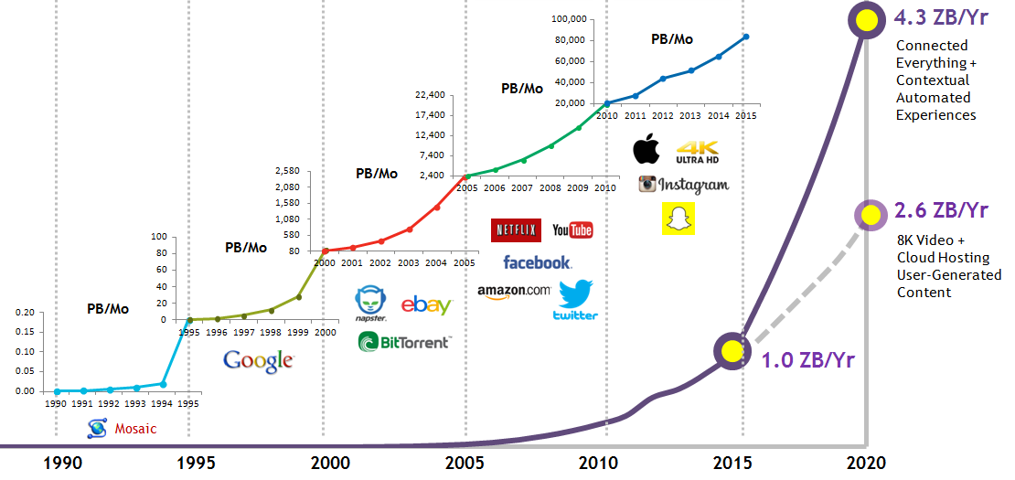



The new digital era
Digitization, delivery & sharing of:
Digitization, distribution
& optimization of:
Enterprises
& Verticals
Consumers

Slide 12
The Future X Network: The 4 Key Business Value Dimensions
10Gbps
Video
360° video
(free viewpoint)
Cloud RAN
Virtual Reality/
Augmented Reality
360° VR/AR
1Gbps
Autonomous
vehicles
360° video (hi-res)
100Mbps
Remote
training
Virtual RAN
We are
here
Bandwidth
10Mbps
360° video (lo-res)
4k Video
streaming
Haptic VR
1Mbps
People & Things
Remote control vehicles
System
Control
HD Video
streaming
100kbps
Cloud-assisted
driving
Sensors
Comms & Chatbots
10kbps
Electric grid
control
1kbps
Home Sensors
10s
1s
100ms
10ms
1ms
100us
10us
Latency
Core Cloud
Edge Cloud
Proprietary

Slide 13
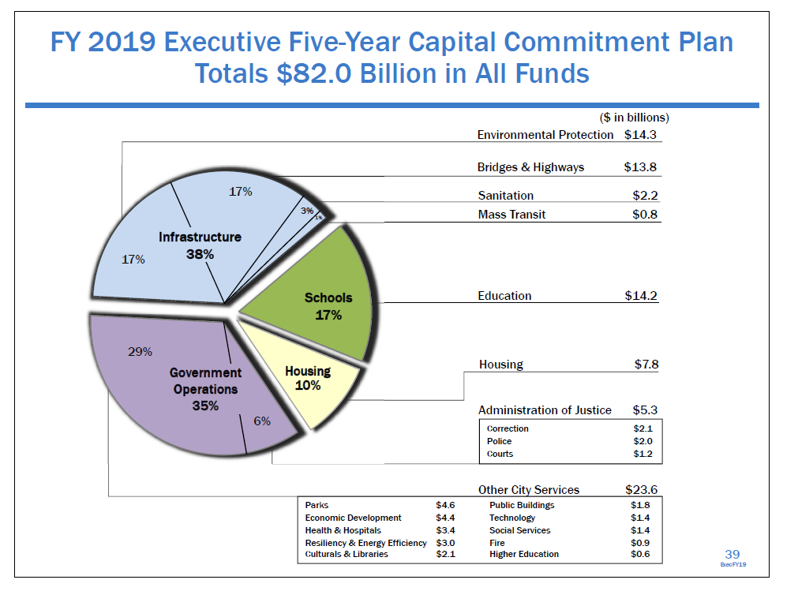
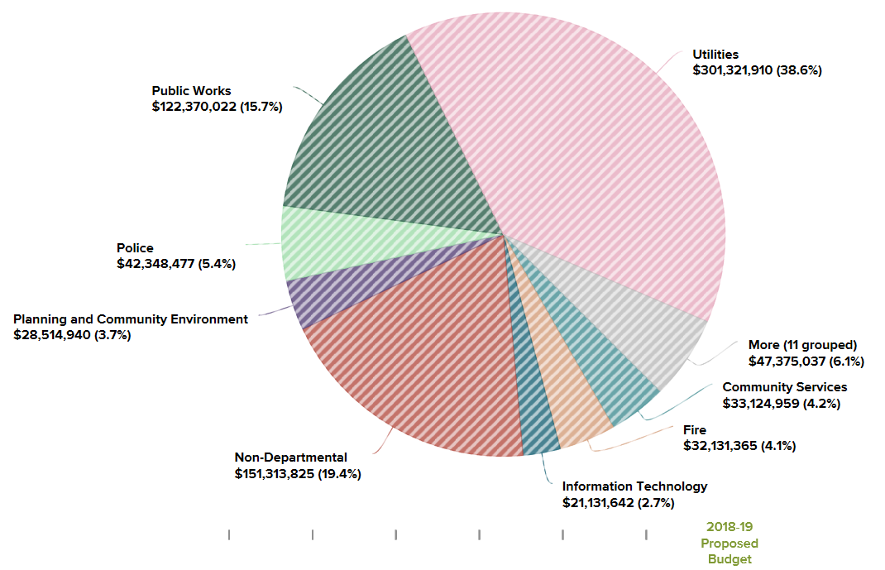
Capital investments and operating budgets are being focused on driving citizen outcomes & operational benefits
Paris, France
Palo Alto, USA

Slide 14































Cities have evolved in their approach to transformation
Collaborative Innovation
Roads, bridges & other spatial Structural Systems
Safety & Security
Human Systems
Quality of Life
Hyper Connected
Sustainability
Core Services
Economic Transaction Systems
Energy & Natural Resource Systems
Resilience
Agility
Economic Growth
Transport & Information Systems
Complex Systems – Humans at Center
Citizen-centric Outcomes
Understanding of complexity, systems, stakeholders
“Science of cities”
Systems must adapt, evolve, renew…..
Six integrated outcome areas measured by Public Value
Convergence of multiple “verticals”
Sustainability, inclusion and resilience critical decision factors
Time to market

Slide 15








Connected Universe
1
2
3
4
5
Connected
Public Safety
Connected Digital Health
Connected
Mobility
Connected Utilities
Connected
Smart Cities

Applications / Tools
Analytics, Security, Partner Applications
Platforms
IMPACT IoT Platform
Devices / Modules / Sensors
Access, IP/Optical/Packet Core/SDM, Airframe, CloudBand
Connectivity
4G/CBRS/WiFi/Fiber/Microwave/Connected Health, Home, Partner Devices

Slide 16
Fundamental shifts needed to create value for cities
1. Evolving
2. Mature
3. Transformational
Citizen Engagement & Deep Insights
City
Focus
Innovation & Value Creating Platforms
Point Solutions
Integrated solutions
Integrated Services
Connected Devices & People
Service Creation & Delivery Platforms
Connectivity Platform
Security
Agency Operations Transformation
Cross-Agency Platforms
Data center transformation
City Maturity
Focus on #3 and #2
Nokia Shift: Connectivity Platform for Digital Transformation
Transformational cities implementing platforms for flexibility, transformation path, value creation. Multi-year, budgeted programs.
Mature cities are implementing full-cycle, integrated solutions for greater business value. Multi-year, budgeted programs.
A large number of evolving cities are exploring point solutions with no clear strategy. Lack strategy, budgets and resources. Led by POC’s
Monetization strategies are most mature in Groups 2 and 3
Digital Transformation addresses 4 key areas:
  Agile Apps for Citizen engagement, segmentation & deep insights
  Apps Transformation for Agency transformation (integration, “joined up”)
  aaS: IaaS and PaaS; hybrid compute infrastructure
  Connectivity Platform becomes a fundamental enabler

Slide 17
Point Solutions
Flood Abatement
Smart Lighting
Smart Parking
Smart Waste
Tracking Solution
Smart Agriculture
Sensing Solutions
Security Solution
Video Analytics
Integrated Operations Center
Smart Energy
Smart Water
Smart Meters(no power source)

Slide 18

What are the building blocks?
Safe
Smart
Sustainable
Funding
Data Analytics and Artificial Intelligence
Data Use/Monetization Strategy
Physical/Digital Infrastructure
Improving digital access.
Public Private
Partnership
Notes:
With the rapid development of opportunities in the IoT marketplace, organizations are challenged in developing business-specific solutions while ensuring maximum reusability across their organization and business units.
Fragmentation in the IoT industry, rooted in disparate devices and applications built on proprietary protocols can stifle innovation. This complex ecosystem makes it harder for application developers to innovate and create new applications cost effectively. In the Telco, enterprise, and municipal space the effects of this complexity are felt in integration cost, management complexity, and time to market for new applications.
A horizontal platform approach, like implemented by Nokia’s IMPACT, drives down costs while enabling mass adoption of IoT applications, as it:
Ensures maximized value of analytics and managed data through end-to-end authentication, security, and privacy;
Delivers value beyond connectivity through richer experience and set of services to customers;
Scales by applying platform functionality across all verticals without building discreet solutions for each application.

Slide 19
Use Cases
-drivers & vision
Notes:
Nokia is a global leader in creating the technologies at the heart of our connected world.
We believe we have the industry’s most comprehensive end-to-end portfolio and services.
We are building extraordinary networks, devices, software and ecosystems… Making communities smarter…transportation safer… enterprises more agile.
We put people in charge of their wellness… experiences… choices… lives… and the way they spend their time.
Robots collaborating with humans
public safety drones saving lives
smart homes that help seniors remain independent and safe
smarter, more sustainable cities and utilities
self-driving cars
remote surgery.
These are just a few of many ways that Nokia touches people lives and connect society.

Slide 20

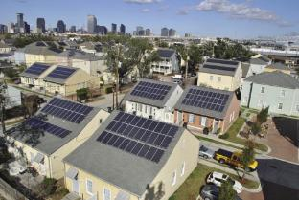





Utility of the Future
Primary Driving Forces
time (sec)
Bulk
Distributed
Rapidly improving economics of
renewable generation, storage
Increased variability
in supply, demand
Regulation

Slide 21
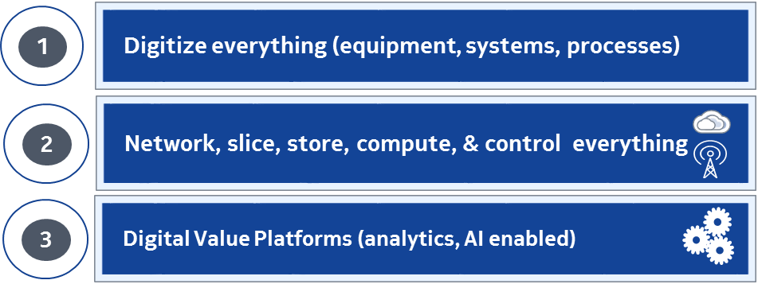
Digitize Everything that Matters
Equipment, Systems, Processes
Transmission Substations
RTUs / IEDs
CCTV Cameras
Synchrophasors
Transmission Towers
DLR
CCTV Cameras
Distribution Substations
RTUs / IEDs
CCTV Cameras
Distribution
Automation
Reclosers
Capacitor Banks
Switches
Distribution Transformers
...
0123
0123
Gas Ops & Storage Station
0123
Mobile Field Force
Mobile Data Terminals
Data and
Operations Center
Distribution Automation
Operations Center
Distributed Generation (DG)
Energy Resources
Energy Storage
DG Collectors
IoT Devices (Pole-top)
Sensors
Sensor Collectors
Metering
Meters
Meter Collectors
Generation
Transmission
Distribution
Connecting everything → wireline + wireless

Slide 22

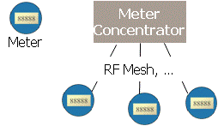


Network, Store, Compute & Control
Everything That Matters
ALL-IP (IP/MPLS)
INFRASTRUCTURE
Substations
Control Centers
Data Centers
Generation
IP WAN
over
Fiber,
Microwave
(MPLS)
SUPPORT OF
LEGACY APPS
AND INTERFACES
External
Networks
Backbone
Routers
External
Networks
Edge
Routers
SCALABILITY
Wireline Service
VPN, P2P Ether, VPLS, …
Wireless
LTE, 3G, …
Leased Lines
T1, …
Private
PLC, GPON,…
Field Area
Networks
MULTIPLE
LAST-MILE
OPTIONS
DA
IEDs
PMUs
Traffic
Aggregation
MISSION-CRITICAL
PERFORMANCE,
RELIABILITY,
SECURITY
EV Charging
Stations
Mobile
Workforce
Substations
Advanced Metering
Infrastructure (AMI)
Field Area Network
DER
Substations
storage
EMS
Distributed
Generation
Microgrids
Proprietary

Slide 23
Digital Value Platforms
Analytics, AI-enabled
AI
High data scale
Low knowledge scale
Demand
Prediction
Human checks machine
Grid Control
Computation
AugI
Diagnostics,
Restoration,
Field Force Automation
Low data scale
High knowledge scale
Machine aids human
HI
Teleprotection
Best effort
Criticality
Life & Death
Proprietary

Slide 24










Nokia Neural Utilities Architecture Applied to Cities
Subsystems
Nokia Integrated Operation Center platform
Utilities functions
Visualization & Orchestration
Telephony, video conf., LAN, network
KPI’s & Analytics
Multi-dimensional reporting
Correlated Dashboard
R&D Initiatives
Legacy PMR gateway
Event Rules
Multi-Geo KPIs
Alert / Incident Management
Procedures / Workflows/ SOP
Machine Learning & Augmented Reality
Strategic Projects
Distribution Automation
Virtualized Network Functions
Dynamic Security
Services & System Integration
Utilities Application Layer
Workforce Safety & Management
SCADA & System Protection
Closed loop System
Augmented Cognition Systems
Asset management (Sensors, devices, Grid)
Video analytics system
Programable Network OS
Data and Telemetry
Energy Management Systems (DMS, TMS)
Converged
Edge
Smart Network Fabric
Universal Adaptive Core
Emergency alert
Operational Dashboards
Nokia Neural Energy Platform
Control & Data centers
Regulatory & Standards
Connectivity Networks
Access Control
Positioning Location, AVL, GIS

Slide 25
Integration with Future X Architecture
Digital Value
Platforms
8
Dynamic
Data Security
7
ANP, CSP, ICP, Vertical apps
External data sources
New trust framework
Ecosystem sharing
Mass edge monitoring
Augmented
Cognition Systems
Machine
learning
6
Analytics
Open APIs
Programmable
Network OS
Dynamic
customer
services
Management &
Orchestration
Dynamic
network optimization
Multi-operator
federation
5
SDN
NFV
4
Universal
Adaptive Core
Common data layer
Access agnostic
converged core
modular, decomposed
network functions
self-optimized
coverage
& capacity
3
Smart Network Fabric
Short
waves
& wires
Long
fibers
Emerging Devices & Sensors
Massive
Scale Access
Software defined, end-end
Access
Remote
0
1
2
Converged
Edge Cloud

Slide 26
Nokia Neural Utilities Architecture Applied to Cities
Subsystems
Nokia Integrated Operation Center platform
Utilities functions
Visualization & Orchestration
Telephony, video conf., LAN, network
KPI’s & Analytics
Multi-dimensional reporting
Correlated Dashboard
R&D Initiatives
Legacy PMR gateway
Event Rules
Multi-Geo KPIs
Alert / Incident Management
Procedures / Workflows/ SOP
Machine Learning & Augmented Reality
Strategic Projects
Distribution Automation
Virtualized Network Functions
Dynamic Security
Services & System Integration
Utilities Application Layer
Workforce Safety & Management
SCADA & System Protection
Closed loop System
Augmented Cognition Systems
Asset management (Sensors, devices, Grid)
Video analytics system
Programable Network OS
Data and Telemetry
Energy Management Systems (DMS, TMS)
Converged
Edge
Smart Network Fabric
Universal Adaptive Core
Emergency alert
Operational Dashboards
Nokia Neural Energy Platform
Control & Data centers
Regulatory & Standards
Connectivity Networks
Access Control
Positioning Location, AVL, GIS

Slide 27
Next Steps
Steering Committee
  Collaboration across all agencies
  Representation from Anchor institutions
  Citizen Engagement & Needs Assessment
Connectivity Roadmap
  Backhaul Inventory and Assessment
  CBRS Strategy
  Massive Connectivity Options- Getting Ready for 5G!
Business and Operational Models
  Public Private Partnership
  Funding & Sustainability Partners

Slide 28
Comprehensive portfolio and expertise
Mobile
Networks
Fixed
Networks
IP / Optical Networks
Applications
& Analytics
Global
Services
Nokia Technologies
Nokia
Bell Labs
Notes:
Our six business groups, together with Nokia Bell Labs, span the different technologies and domains to form what we believe to be the industry’s most comprehensive end-to-end portfolio and expertise.
Mobile Networks enables massive-scale access and the converged edge cloud. 4G, 5G, licensed and unlicensed spectrum, small cells, digitization and virtual telco cloud, self-optimizing capabilities … we are present in essentially all the key technologies in this domain, and differentiate through our capabilities in comprehensive and innovative services.
Fixed Networks is a leading access player spanning copper, fiber, and cable access, and also has assets in the digital value platform area in the form of residential gateways and interesting opportunities in automating the digital home. With technology developed by Nokia Bell Labs, we have pushed the limits of transmission through copper, adding new life to our customers’ assets and creating profitable opportunities beyond anything previously envisaged for the world’s existing copper networks.
IP and Optical Networks plays across multiple domains, from programmable IP and optical transport networks for the smart fabric to software-defined capabilities for the programmable network OS and more.
Applications & Analytics provides intelligent software to drive digital monetization, digital operations and digital networks. It incorporates this intelligence into its other portfolio offerings, which include cloud and virtualized network functions, security, advanced IoT platforms, as well as proactive customer care and device management.
Global Services leverages extreme automation, analytics and artificial intelligence to provide the full lifecycle of services that our customers need to ensure their networks create business value for their subscribers, employees and constituents.
Nokia Technologies is licensing the Nokia brand, key technologies and our fundamental intellectual property that allows the network and connected devices to function… as well as creating new businesses with consumer devices and value platforms in digital health.
Nokia Bell Labs is Nokia’s innovation and research powerhouse, and seeks the solutions to the most fundamental technology challenges, solving problems 10 years out and taking a “future-back” approach to focus scientific research that directly leads to commercialization and implementation through other business groups.

